Slide 1

S&P Global Inc.: Financial Overview

Slide 2

Members
Nitin
Alisha Mahajan
Gaurav Negi
Harshita Sanjay Dhiman
Pallavi Rajendran

Slide 3

Introduction
SPGI refers to S&P Global Inc., a leading provider of financial market intelligence, data, and analytics.
The company has 40450 number of employees globally .
No of offices Globally 70 Offices in 28 countries.
Share Price as on today $435.00 USD.

Slide 4
History
Early Years: Founded in 1888 by James H. McGraw as a publishing business focused on educational materials.
Merger with Hill Publishing: Merged with John Hill's publishing house in 1909 to form McGraw-Hill Publishing Company.
Expansion and Diversification: Expanded into new areas such as financial services, information services, and broadcasting.
Financial Services Focus: Increased focus on financial services division in the latter half of the 20th century, including Standard & Poor's (S&P) Corporation.
Rebranding as S&P Global: Rebranded from McGraw-Hill Financial in 2016 to reflect core business and global reach.
Financial Intelligence Solutions
Market Data Providers
Financial Analytics and Research Firms
Index Providers
Credit Rating Agencies
Regulatory and Compliance Solutions
Artificial Technology solutions (with Kensho Technologies)

Slide 5
Current operations
Credit Ratings: Providing credit ratings, research, and insights on bonds and securities worldwide.
Market Intelligence: Offering data, analytics, and research solutions to financial institutions and corporations across various industries.
Indices: Creating and managing stock market indices like the S&P 500 and Dow Jones Industrial Average.
Platts: Providing information, pricing, and analytics for energy, petrochemicals, metals, and commodities markets.
Risk Solutions: Offering risk management solutions including credit risk assessment and regulatory intelligence.
Data and Analytics: Offering proprietary data sets, analytics tools, and custom research services.
ESG Solutions: Providing ESG data, ratings, and analytics to help investors and companies integrate ESG factors.
Market Research: Offering in-depth research reports and insights across industries like banking, healthcare, and technology.

Slide 6
Macroeconomic environment S&P Global has historically pursued a combination of organic growth, strategic partnerships, and selective acquisitions to expand its business and maintain its position as a global leader in financial information and analytics.
Organic Growth:
S&P Global consistently invests in developing new products and services internally to meet the evolving needs of its clients. This approach allows the company to innovate and enhance its offerings while leveraging its existing resources and expertise.
Strategic Partnerships:
S&P Global has formed strategic partnerships and joint ventures to complement its capabilities and expand its reach in key markets.
Collaborations with other industry players or technology firms enable S&P Global to leverage synergies, access new markets, and offer integrated solutions to customers.
These partnerships enhance S&P Global's competitiveness and help drive growth by combining complementary expertise and resources.
Selective Acquisitions:
While S&P Global has engaged in acquisitions to strengthen its business, the company tends to be selective and focused on strategic targets that complement its existing offerings and enhance its competitive position.
Acquisitions allow S&P Global to accelerate growth, enter new markets, and acquire specialized capabilities or technologies. Notable examples include the acquisitions of SNL Financial in 2015 and IHS Markit in 2020.
S&P Global evaluates potential acquisitions based on their strategic fit, financial viability, and potential for value creation, considering market conditions and regulatory considerations.

Slide 7

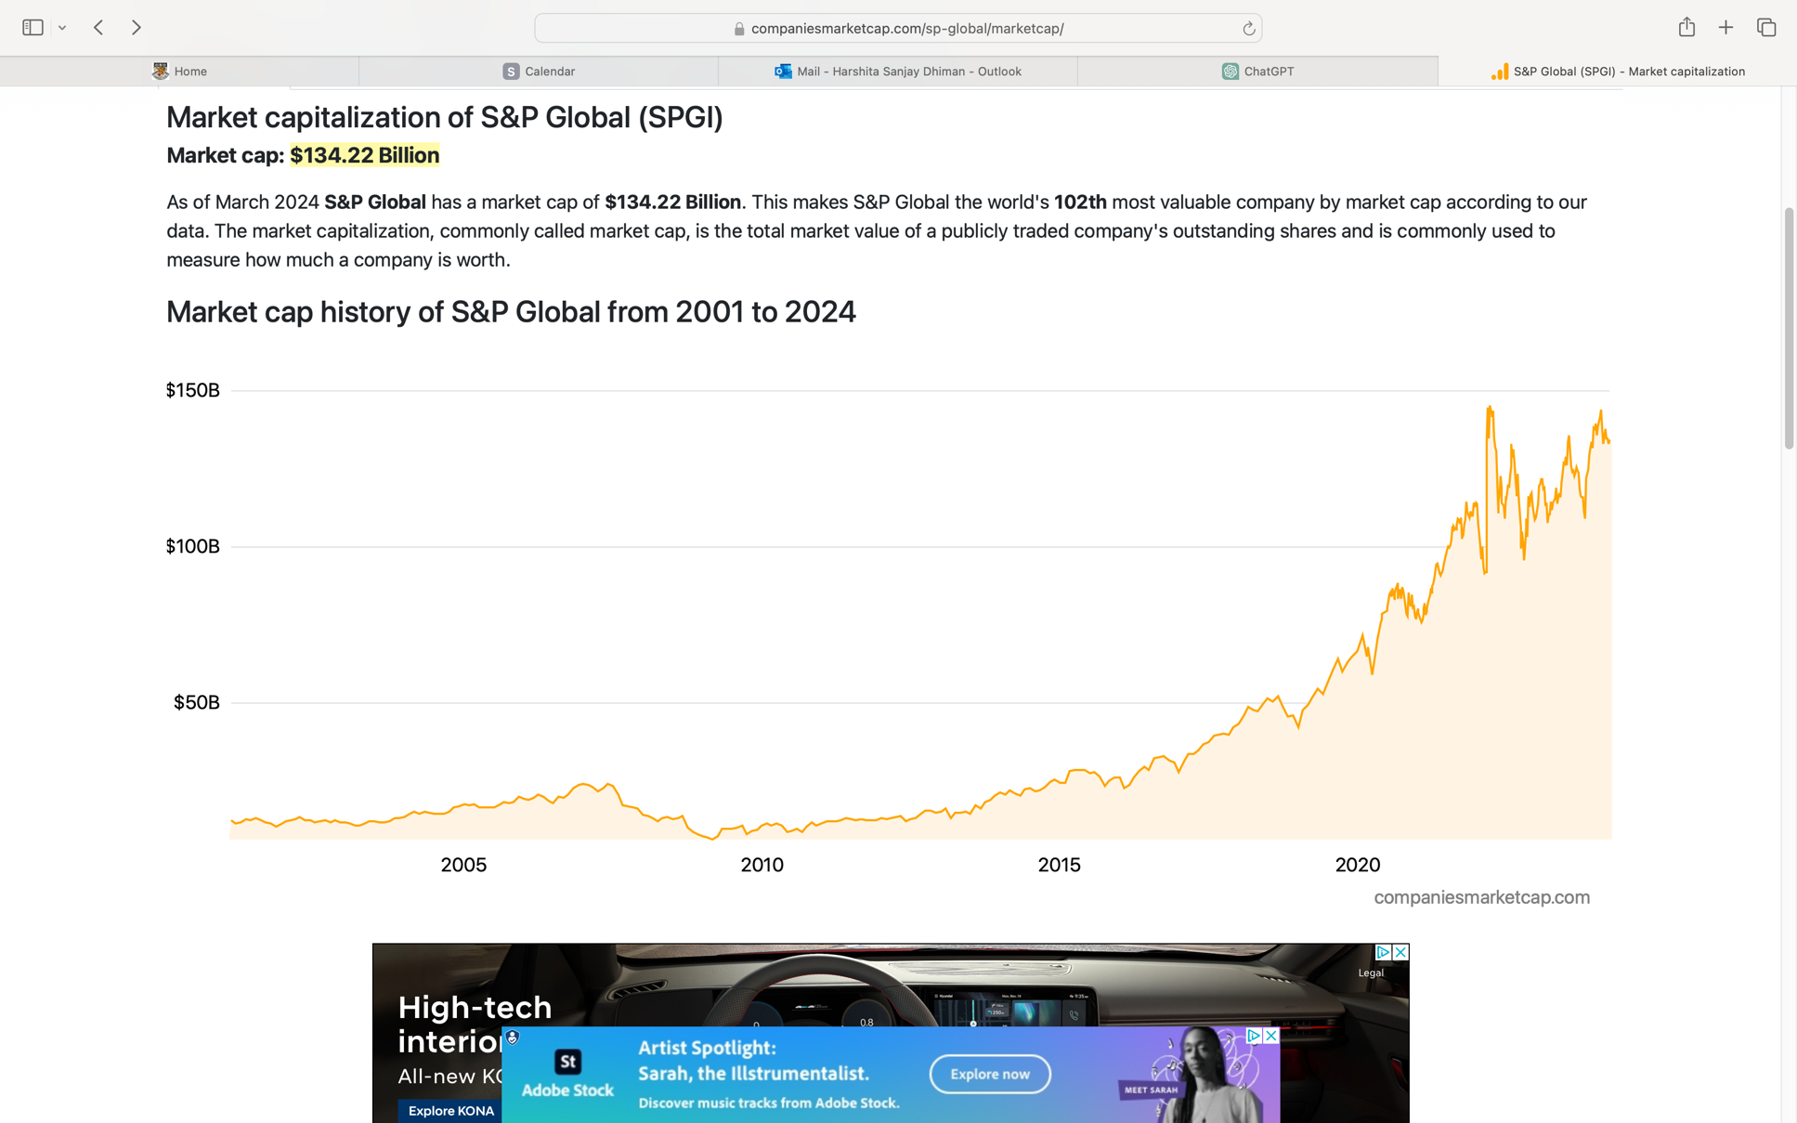
MARKET CAP
134.23 billion USD
This makes S&P Global the world's 100nd most valuable company by market cap according to our data.

Slide 8
Competitors
NAME | CHG % | MARKET CAP
Moody's Corp. | -2.02% | $70.77B
Thomson Reuters Corp. | 0.54% | $95.98B
MSCI Inc. | -1.89% | $43.75B
Experian PLC | 0.52% | £31.83B
Equifax Inc. | -0.68% | $32.74B
FactSet Research Systems Inc. | -0.71% | $17.04B
Morningstar Inc. | -0.48% | $12.98B

Slide 9
Ratio Calculations
Ratios | Company SPGI Ratio | Comments
Current Ratio | 0.84 | Less than 1 denotes a liquidity ratio, while a solid value is between 1.5 and 2.
Quick Ratio | 0.84 | No. should be more than 2, and because it is less than 1, the liquidity situation is once poorer.
Debt-to-Equity Ratio | 0.33 | Because the corporation depends more on equity than on debt, it is less than 1.
Inventory Turnover Ratio | 0.00 | Inventory = 0
Gross Profit Margin | 66.86% | The company's gross profit margin is higher than the 10.7% average of the S&P 500.
Return on Sales Ratio | 32.17% | When compared to other financial services companies, this one has a very impressive return on sales ratio.
Return on Total Assets | 4.77% | The return on total assets of the firm is higher than that of the banking industry, which usually stays below 1%.
Return on Equity Ratio | 8.46% | Greater the ROE, the more profit the business makes for each dollar invested by shareholders.
Earnings per share | $8.25 | The company's profits per share (EPS) is higher than the $3.15 benchmark set by the banking industry.
Price/Earnings Ratio | 50.32 | The price-to-earnings ratio (PE) of the firm is higher than the 34.63 PE for the banking sector.
Dividend Payout Ratio | 0.49 | The S&P Global company's dividend payout ratio is highly favorable and is drawing significant investor interest.
Retention Ratio | 0.51 | Reinvestment of earnings by S&P Global is increasing.

Slide 10
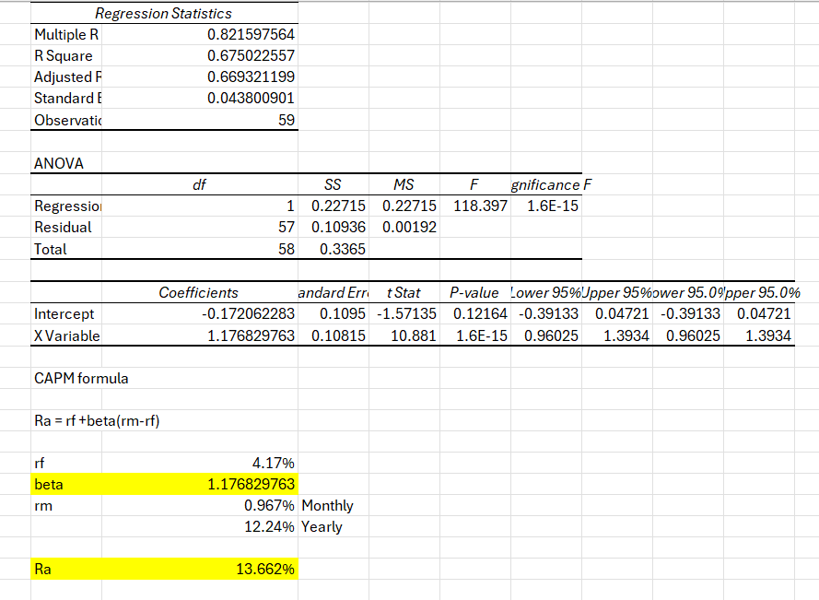
Capital Asset Pricing Model

Slide 11
WACC
WACC
Input Data
Cost of Debt | 5.05%
Cost of equity | 8.42%
Output
Weight of Debt | 8%
Weight of Equity | 92%
TOTAL | 100%
WACC | 8.15%

Slide 12
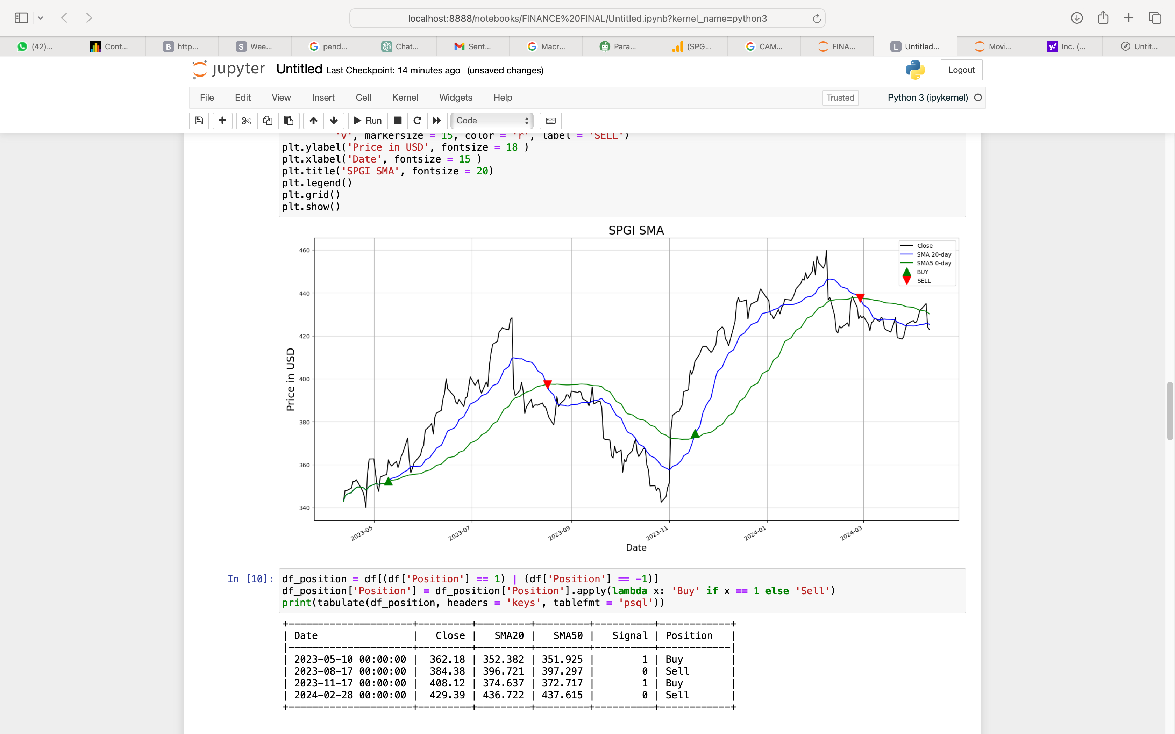
SMA

Slide 13
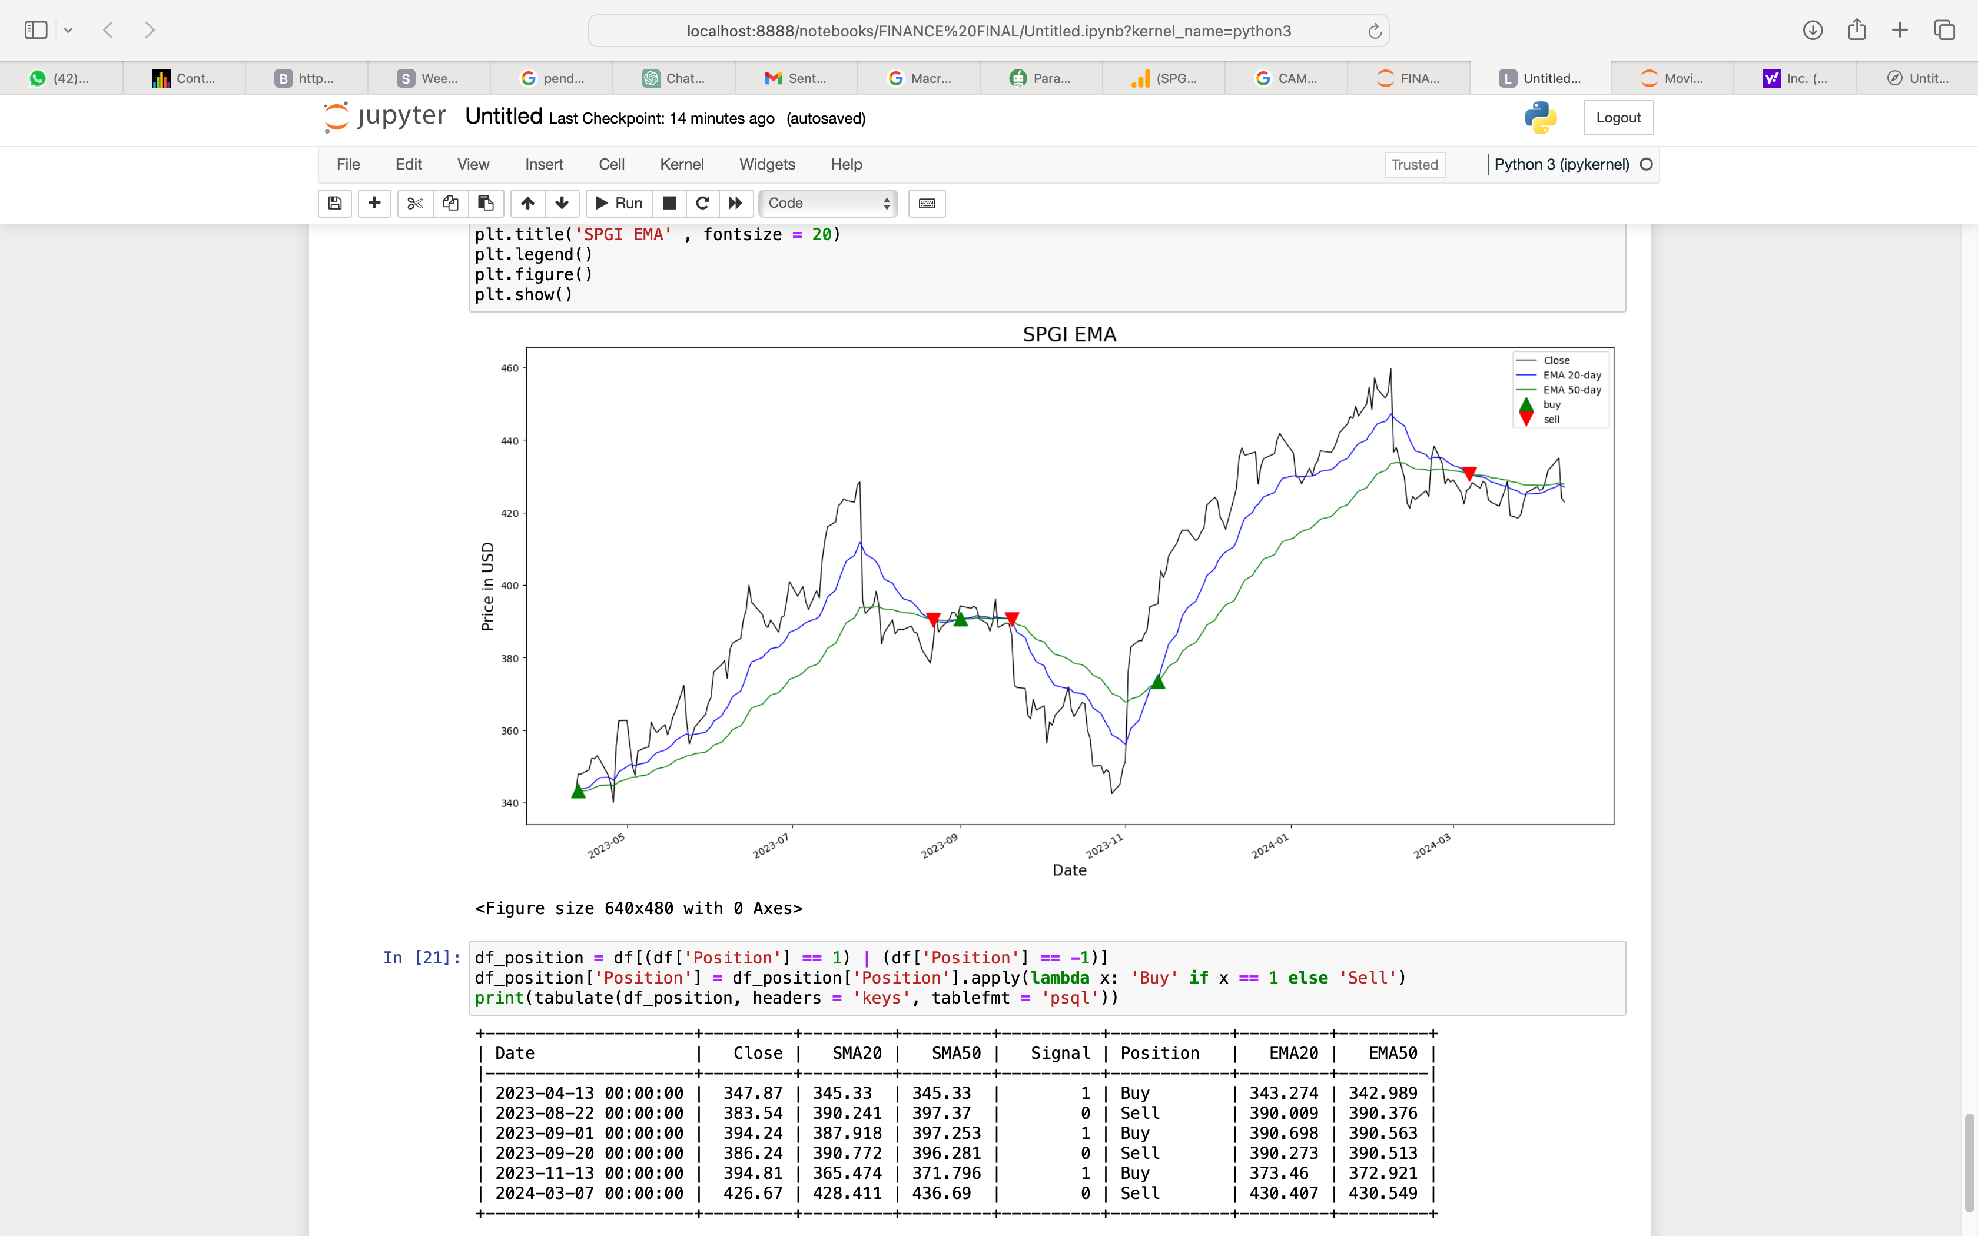
EMA

Slide 14
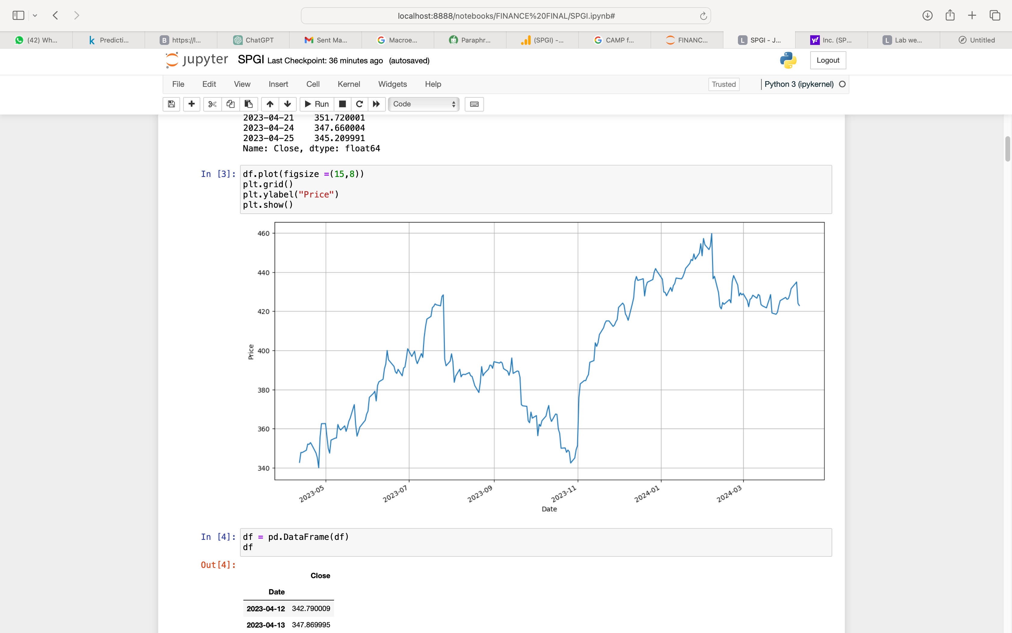
Stock price for a year
In the chart we can see that there is sudden hike in Nov 2023 which as per research was a period where Sentiment Quickly Turned Bullish for stock buyers .

Slide 15
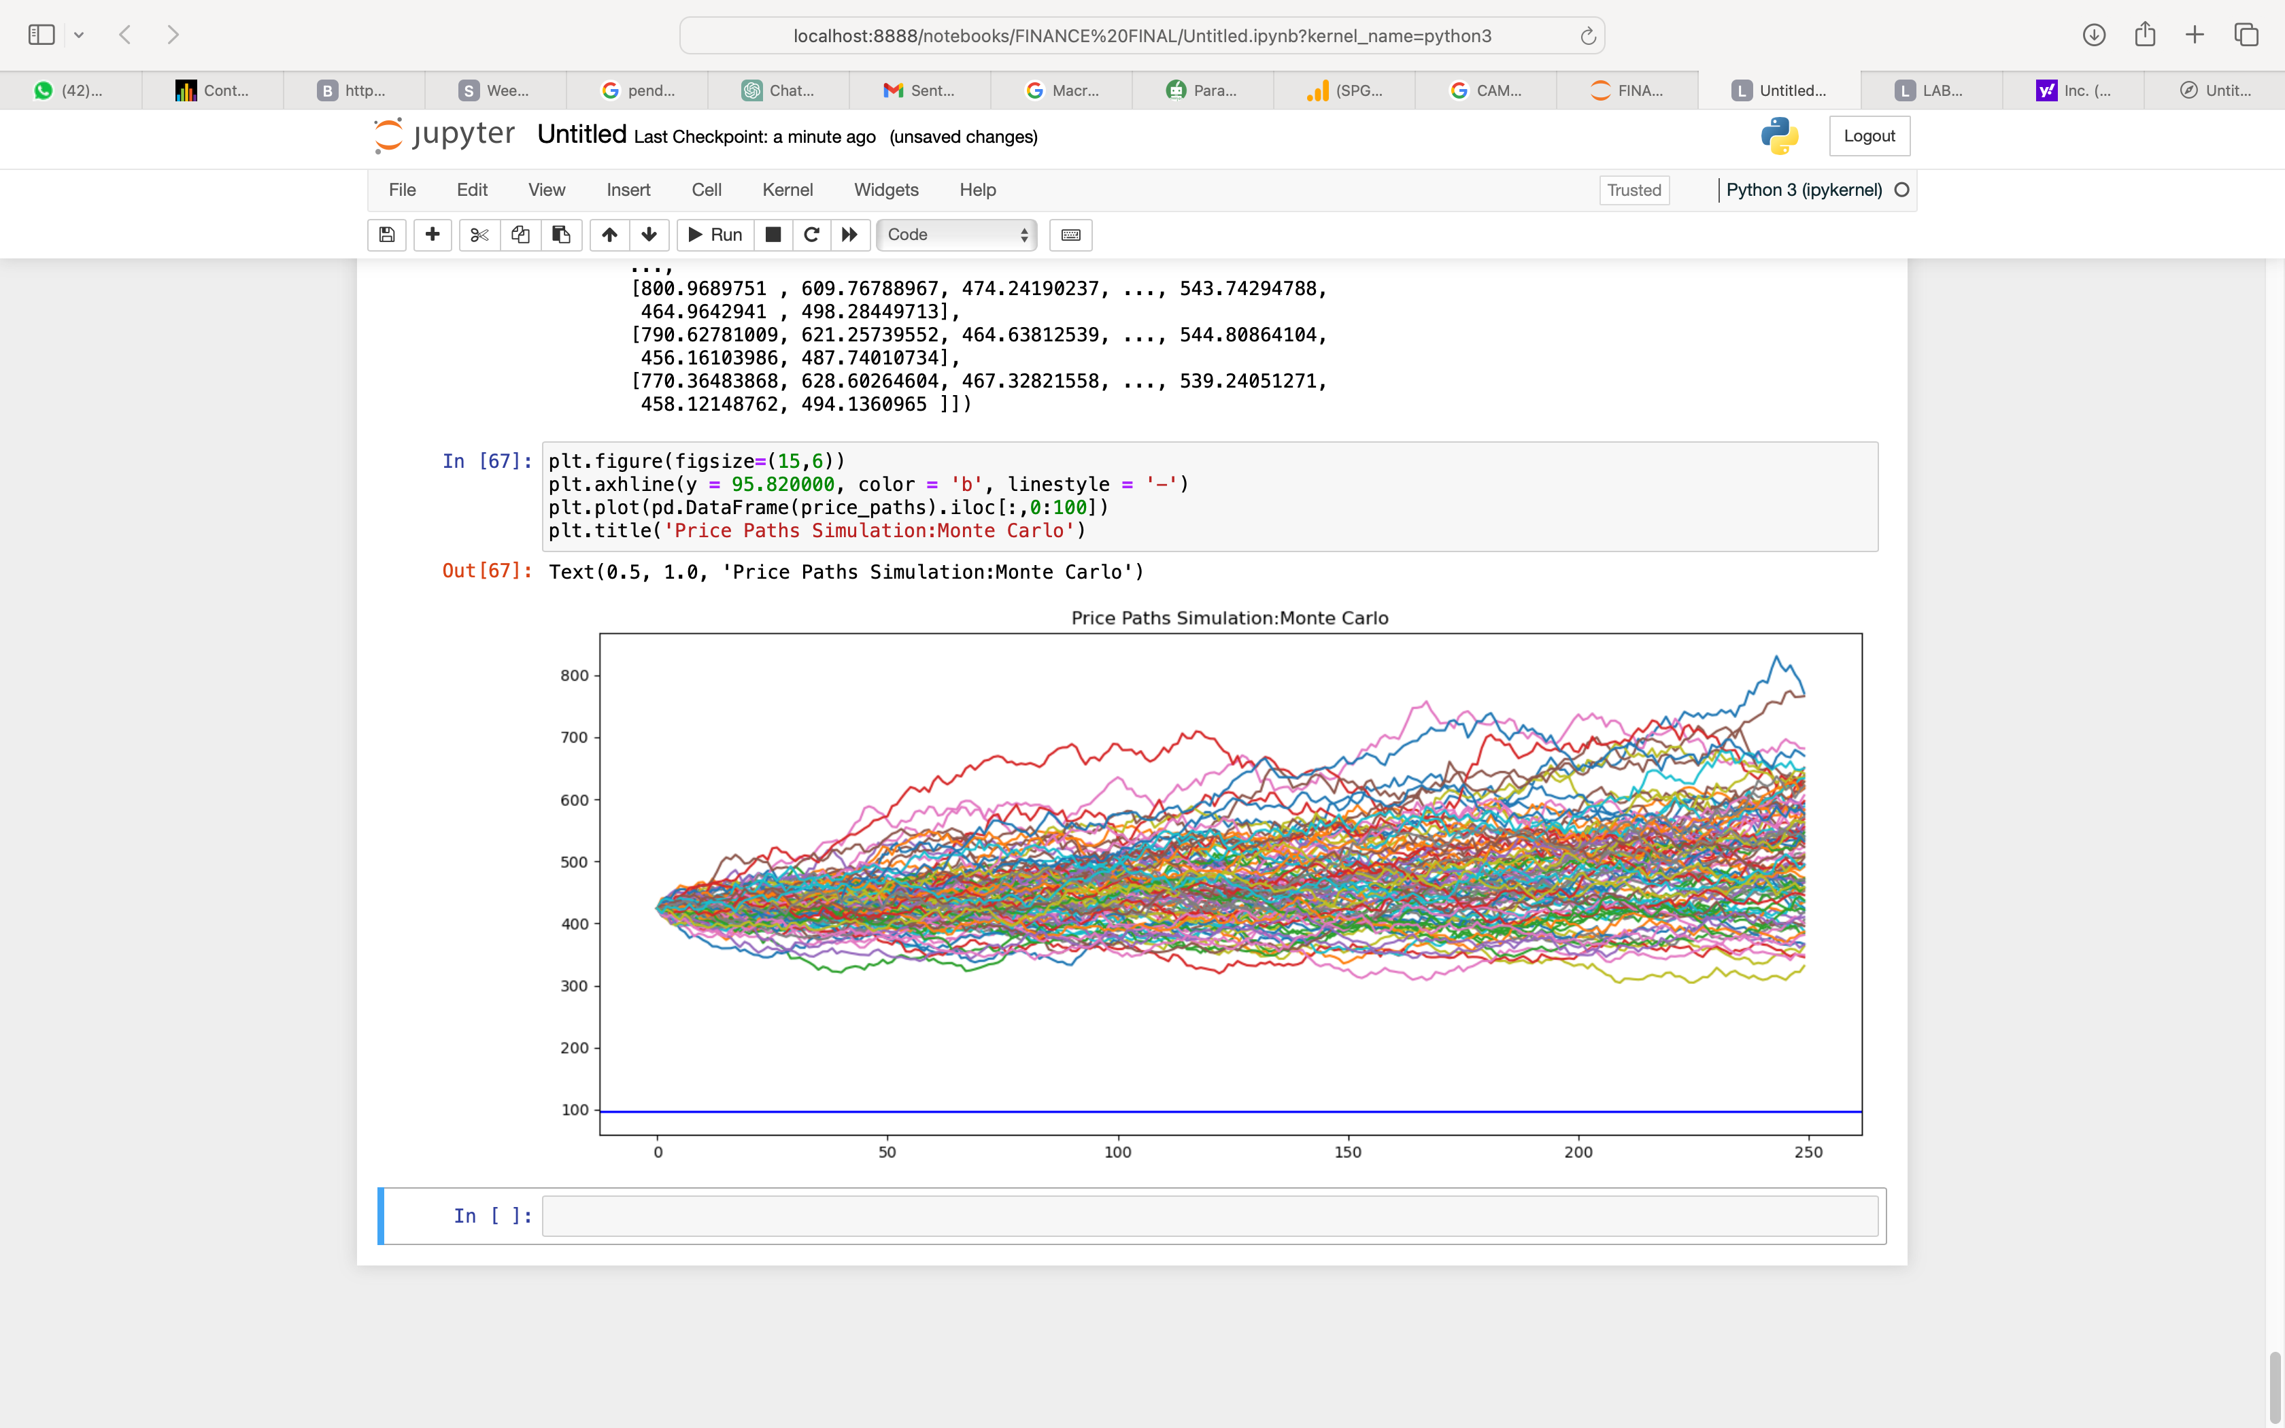
Monte Carlo Simulation Benefits: Provides insights into the range of possible outcomes and their probabilities, helping decision-makers make informed choices. Accounts for uncertainty and variability in complex systems, improving risk assessment and planning. Allows for sensitivity analysis to identify the most influential factors and assess their impact on outcomes.

Slide 16
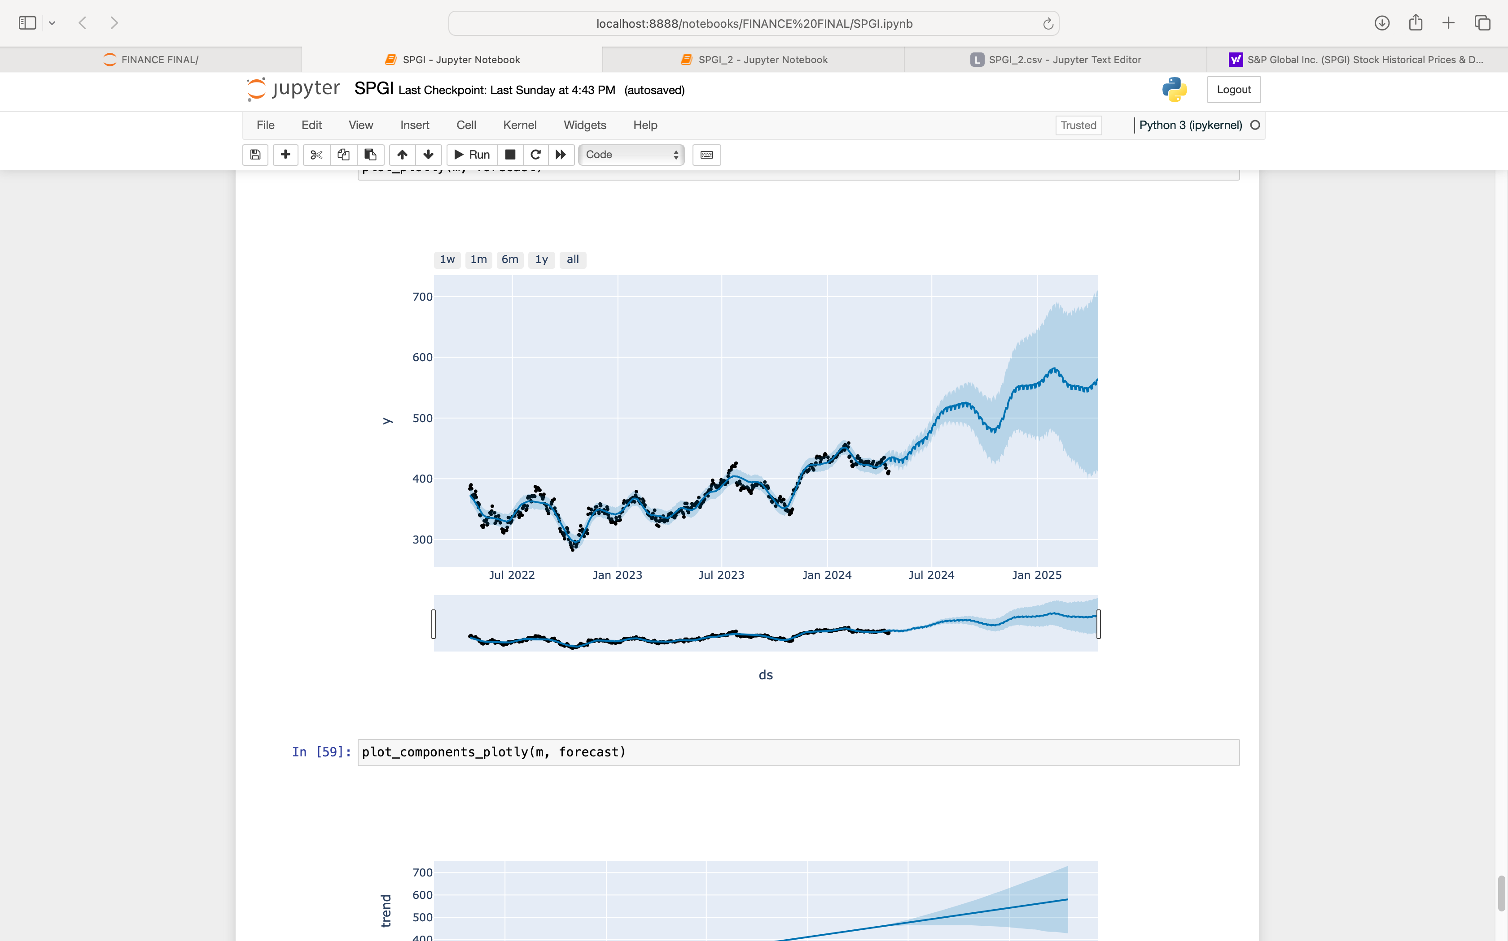
Facebook Prophet
Facebook Prophet: An open-source library for time series data forecasting, utilizing an additive regression model.
Features: Uses additive modelling to anticipate and includes nonlinear trends, daily, weekly, and yearly seasonality, as well as holiday effects. Ideal for large amounts of historical data and time series data with seasonal impacts.
Capabilities: Analyzes market values and facilitates future predictions for individuals and businesses.

Slide 17
Recommendations
Considering the optimistic prognosis for SPGI stock, we strongly advise purchasing and keeping it. Our estimate predicts that it will rise beyond $470 USD in less than a year.
The firm is a desirable place to invest because of its strong market position and broad portfolio. Consistent sales growth, acquisitions, and partnerships point to a positive prognosis.
Holding current SPGI holdings and purchasing may be explored, but careful observation of market dynamics and business advancements is essential.

Slide 18

References
https://www.alphaspread.com/security/nyse/spgi/discount-rate
https://finance.yahoo.com/news/p-global-inc-spgi-reports-123429467.html?guccounter=1&guce_referrer=aHR0cHM6Ly93d3cuZ29vZ2xlLmNvbS8&guce_referrer_sig=AQAAAJD2pQvSV8WDR7f69nXyEuLGVjuzYhm0W8JvQ9EXrTknZR4zErTJIZpNlNc0R_ejFY7PfHtDmyaZQ4z9A-iXdIrBmxLWFF06QARnwT7cCRKLho5-ht6OVnl4LqlckNX-X9sMj0VuKv00y_y2LaSHwZUuCQHH2fWm2ntGDpfku74f#:~:text=Capital%20Allocation%20and%20Shareholder%20Value,free%20cash%20flow%20to%20shareholders.
https://companiesmarketcap.com/sp-global/marketcap/
https://finance.yahoo.com/quote/SPGI/profile
https://finance.yahoo.com/quote/SPGI/history
https://www.spglobal.com/en/contact-us/office-locations
https://www.gurufocus.com/term/InventoryTurnover/SPGI/Inventory-Turnover/S&P-Global

Slide 19

Thankyou

